Slide 1
"Leading for Dysfunction: The Dichotomy Between Leadership & Performance"
and
By Cora Lonning and Sandra Tibbs
PowerPoint Presentation available at: http://www.neverestsolutions.com
Scroll down to Resources

Slide 2
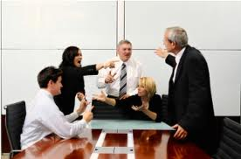
Notes:
Think back to the last time you were dragged into the drama or witnessed drama in your organization? You are not alone, every leader has been there. Organizations, no matter how big or small, will have drama as long as it is made up of people. If you ask a leader what is their biggest leadership challenge, it always boils down to people. How do you spend the majority of your time as a leader? Planning strategy, creating a vision, creating a product? Chances are that you spend it on dealing with people and their drama! …and let’s face it…sometimes the drama is created by the leader. The more drama there is in an organization, the less work that is getting done. Think back to the last time you were dragged into drama. How long did you spend solving the issue? Negativity can be infectious and spread like a virus. But drama takes it to another level and occurs when bad behavior, gossip, or lack of team effort decreases work performance. When these behaviors fracture the team spirit it can be detrimental for all involved.
Drama almost always leads to a breakdown in workplace relationships. And it can go from a small conflict into a full blown episode of drama. And then we are left drained, confused, angry and with the other million things we have to take care of undone. So that adds even more stress into our life which then shows up in our personal life as well
Every workplace is plagued with manipulative people who use emotion to create conflict in order to cover-up for their lack of substance. These are the drama queens/kings that when confronted about wrongdoing and/or lack of performance are quick to point the finger in another direction. They are adept at using emotional tirades which often include crocodile tears, blame shifting, little lies, half truths and other trite manipulations to get away with total lack of substance.

Slide 3
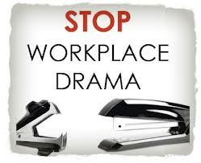
Democracy must include an objective selection committee so that the best leaders could be presented by their peers…
Notes:
Leaders are responsible for setting the tone in their organizations. Therefore, leaders must be able to develop the skills needed to stop workplace drama or at least reduce it. This presentation, will provide you with a tool that you can add to your tool bag.

Slide 4
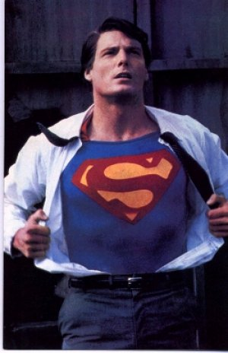
Notes:
As leaders it is our responsibility to provide people with the tools they need to succeed and one of those tools is to let people sort out their own problems, their own conflict. We have to understand that we as leaders and those people who are leading us are not super heroes, therefore they are going to have imperfections, biases, human needs and are also vulnerable to be sucked into the drama.
What do we expect from our leaders today? What do we expect from ourselves as leaders? Employees are looking for a person who will give them the tools to succeed. And there is nothing wrong with that. Where it becomes a problem is when employees expect leaders to solve their problems and take complete responsibility for their actions. In this case, they are failing to own their own power. And as leaders, we need to be aware of not committing that mistake of crossing the line and assuming responsibility for others when is not our place to do so. Yes, we have to take responsibility for our actions but let’s face it, there are people who are not going to perform and are not going to change. We have to understand that we are not superheroes, we are human beings with strengths, areas for improvement, biases and influenced by our surroundings as well. How can we always stay on top of our game, we need to develop ourselves as leaders. And we need to make a conscious effort to not be dragged into the drama in the workplace. This starts with awareness of the games that people play sometimes in the workplace.

Slide 5
Why do people play games?
Scripted Roles
Protection/Denial/Self-defense
Meet their needs:
Fear of rejection
Wanting to be of help
To feel superior
Notes:
Let’s look at why people play games. More times than none, people are not aware that they are playing a game and asking others to play with them. These are subconscious actions that are a result of scripted roles programmed in us since we were little from our parents, culture, environment. When people are confronted with a stressful situation or a situation that triggers one of these scripted roles they revert to it and ask other people to play along.
The game-playing is manipulation to perpetuate, not resolve, the drama or the situation. It prevents us from finding any real or lasting solutions. It produces confusion and upset feelings, behind which players can hide. It avoids taking responsibility for addressing broader dysfunction in relationships. And it does not acknowledge the damage caused in the game.
Games help confuse the situation and avoid clarity by:
• Self-protection - making it all a game
• Denial - denying it is a game; and
• Self-defense – putting others on the defensive e.g. talking, not listening.

Slide 6
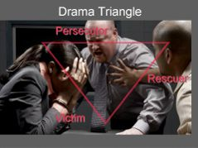
Notes:
After Kelly was promoted, Pat, a former colleague who had also wanted the promotion, spread nasty rumors about Kelly’s competency. Kelly fired back at Pat by documenting weaknesses, inadequacies Kelly only knew because the two had once been teammates. Another ex-colleague, Jordan, who had never coveted Kelly’s new position, jumped into the fray to create a drama triangle.
Jordan felt like Pat was being victimized and tried to cover for him by taking away some of Pat’s responsibilities. Instead of being grateful to Jordan, Pat was furious and lashed out at Jordan, “You must be agreeing with Kelly that I’m incapable. Otherwise, you’d never try to cover for me. You’d let me sink or swim based on my own merits.” Jordan was shocked, “Ouch! I was trying to help. You don’t appreciate me and you’re taking our friendship for granted.”
The scenario above is an example of what is call a drama triangle. The Drama Triangle is a seductive high-energy blame-game which serves to redirect the focus of attention, energy and dialogue from personal accountability to the engaging interactions of blame, defense and rescue. The Drama Triangle game depicts the human drama found in all great dramatic literature. All drama involves a victim, rescuer and persecutor* (*aka: villain.) Drama games generate excitement but defeat accountability, critical-thinking and personal power. Most people learn the power of being a victim, persecutor or rescuer as potentially powerless children. Wise people realize that drama games invert the truth about interpersonal power. Victims appear powerless, when in fact; victims are the most powerful players in drama games. Dramas are created and sustained by people who exchange the satisfaction of adult-thinking and accountability for the drama of powerlessness, blame and rescue. Wars, politics, and organizational cultures are imbued with drama games All three roles need each other – and if you play one role on the triangle – in time – you’ll play another. Victims attract rescuers and both need someone to blame. Rescuers need a victim to feel worthwhile. Unwitting rescuers are “do-gooders” without boundaries. Persecutors always find their victims. Unwitting persecutors can be people simply inviting accountability – but become labeled “the bad guy” for interfering with someone’s intent to avoid accountability. The roles and conversations of the drama game players are recognizably consistent no matter what the details of the scenario. The greater the payback for being a victim, rescuer or persecutor, the greater the intensity of the drama. The greater the intensity of the drama the more distracted from the truth - the players will be. Imagine what happens when someone suggests being accountable. Drama Triangle players develop an affinity and therefore skill for participating in interpersonal drama. Most drama players prefer the excitement and adrenalin of drama over the perceived boredom of the truth. There’s a price to pay for participating in the Drama Triangle. At the conclusion of each dramatic interpersonal scenario players experience a descent from autonomy and personal power into a vague sense of ennui; an increased proclivity for guilt, cynicism, and personal isolation; and a declining ability to perceive good intentions and truth. Many Drama Triangle players live their entire lives within the perspective roles of the drama triangle. When players finally release themselves from the “trance” of drama games they experience relief and a renewed sense of personal power and self-confidence. The practice of being accountable for the all the choices we make – empowers us to create a life we can be grateful for and proud to live, share and remember.
Who played the role of victim? Perpetrator? Rescuer? When did the players switch roles?

Slide 7
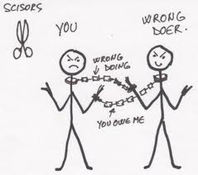
The Dysfunctional Relationship

Slide 8
The Drama [Game] Triangle
Unspoken Message
“ I am helpless, you are better than me”
Not OK/ OK
Victim
Not OK/Ok
Persecutor
OK/Not OK
Drama Triangle
Rescuer
OK/Not OK
Unspoken Message
“ I know more than you, you are inadequate”
OK/Not OK
Unspoken Message
“ I am better than you, you are inferior”
OK/Not OK

Slide 9
By accepting or offering an invitation into the Drama Triangle you are off and running in a negative spiral of dysfunction.
Victim allows other to take responsibility for choices, actions and behavior. Blames; therefore gives up all personal power.
Victim
Not OK/Ok
Persecutor
OK/Not OK
Drama Triangle
Rescuer
OK/Not OK
Rescuer does for others what others are capable of doing for themselves. Enables; therefore arrests development.
Persecutor sets unrealistic, or unclear, expectations that cannot be met. Demotes; therefore prevents success in others.

Slide 11
Exercise
Think back to a recent time when you were part
of a drama triangle or you witnessed one
Who started as rescuer, victim, and persecutor?
Did roles get switched?
What would you do differently to stay out of the drama
triangle or get out of it?

Slide 12
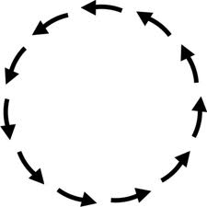
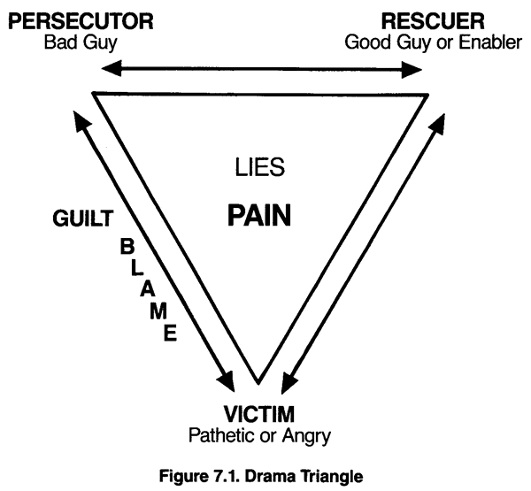
Employee (Or 3rd Party) Turns Persecutor
(Complains rescuer is not performing their role sufficiently and adequately; nor with kindness)
Leader to the Rescue
(Motivated by control, guilt, fear, altruism)
Employee as the Victim
(Feels either entitled or resentful)
Rescuer leader gets caught on the pointed edge of the triangle!

Slide 13
The Play…..
C+G=R S X P
The Con + the Gimmick = a Response, then the Switch, the crossover, and then…the Payoff!

Slide 14
A Situation…
The angry boss, as Identified Persecutor, is scolding and embarrassing the secretary. But secretly the boss is the Victim of the secretary’s careless work, and of his/her own job insecurity based on office production; and is also secretly a Rescuer in attempts to train employees to meet high standards and by openly complaining instead of secretly firing the secretary.

Slide 15
P
( R )
( V )
Boss
C + G = R S X P
Demands High Performance
Wants to please
Scolding
Boss becomes rescuer
Secretary becomes persecutor
I am better than you/you are inferior
Insecurities held a bay….
Notes:
Player A send Con-an invitation in the form of a split transaction. Player B must accept the invitation in order for the game to be played By having a gimmick, some sort of need that A can exploit (need for approval, a need to be seen as wise or superior or inferior) In order for the drama triangle, the game has to take place. A game is a serious of events starting with a con followed by a Gimmick which results in several exchanges or responses. Then there is a switch, a cross-up, and a payoff.
Reasons why people play games: 1. The prospect of meeting mutual needs. 2. Attention. 3. Affirming our life position
Dealing with games:
Familiarizing yourself with the structure of the games you play. Identify and diffuse your gimmicks.
Starting games:
Pay attention to discounts
During games:
Slippery –someone might be putting you down while pretending to be your friend.
To get out of the game you can share your awareness of the game with the other person or respond from adult. Do not use prescripted roles but act as though they do not exist. Unplug, there is little to be gained from someone who is stuck in the dramatic role.
People most of the time are not even aware of their own needs because they are outside of their own awareness. Sometimes we can spend way too much time trying to figure out other people when a more productive strategy is to figure our own selves out and what it is that draw us into games needs instead of just trying to figure out what is drawing us to that

Slide 16
(P )
( R )
V
Secretary
C + G = R S X P
I am incapable
Insecurity
You dirty rotten scoundrel (covertly)
Secretary becomes persecutor
Boss becomes victim
You are better than me, but you NEED me
Boss needs me to feel good about himself….

Slide 17
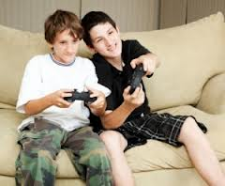
Don’t play the game
Notes:
When an individual is taking responsibility for themselves and allows the other to also take responsibility for themselves, they are adopting the I’m OK, Your OK – (I+ U+ ) position Quad (2). This is a position of equality in which the responsibility of each individual is acknowledged. It is a position of empowerment and is one of honesty, reality and respect. Boundaries, contracts, accountability and responsibility are all active here. The catch phrase for this quadrant is “Get on with”.
Don’t play the game – if you deal with a coworker who is always complaining, stop them in their tracks. Most people who are upset by workplace circumstances want to feel validated so they will continue to vent and try to get others to think their way. If you let that person know, by using assertive communication, that you do not want to discuss negative issues it will not give them the playing ground to continue and they stop (or find someone else who will play with them).

Slide 18
How to avoid the drama triangle
Gather all the facts
Take responsibility
Be self-aware
Maintain boundaries
Balance respect for others and yourself
Accept that others may have things to teach you
Recognize human complexity/know your people
Engage in dialogue
Engage in solution-focused thinking
Collaborate / Negotiate agreement

Slide 19
The triangle of compassion, this is the way out of the game, the dysfunction. This is the path to healthy relationships, productive conversations and leadership.
Vulnerability is the willingness to accept a helping hand, while accepting responsibility. Transparency; not redirection
Vulnerable
Power/
Potency
The OK Corral
Reaching Out
This is the ability to stand in one’s own power and feel one’s own potency, without the need to push others down. Empowerment; not dominance.
Reaching out acknowledges others need a helping hand at times.
Assistance; not disempowerment.
Notes:
When you get into the OK coral. You know that you don’t have to be a victim, a persecutor or a rescuer. You know you have to take responsibility for your actions and then let others take responsibility for theirs. You don’t see yourself or others as inferior. You know that there are strategies to be implemented that work on some situations and not on others. You are able to take criticism and decide what you want to keep or not without being defensive.

Slide 20
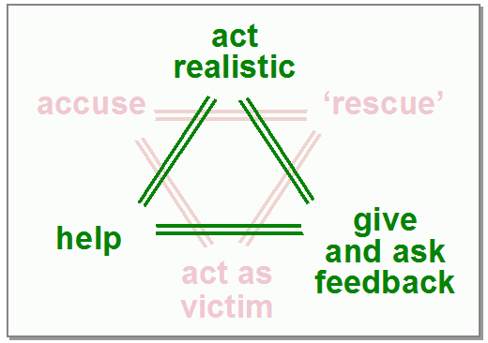

Slide 21
A Situation…
The angry boss, as Identified Persecutor, is scolding and embarrassing the secretary. But secretly the boss is the Victim of the secretary’s careless work, and of his/her own job insecurity based on office production; and is also secretly a Rescuer in attempts to train employees to meet high standards and by openly complaining instead of secretly firing the secretary.

Slide 22
The OK Corral
What specifically does the secretary need to move her out of victim mode?
What specific action does the boss need to take that would move him out of the persecutor behavior?
What needs to happen to move the boss out of his victim fears?
What will remove the secretary’s ability to persecute?

Slide 23
Democracy must include an objective selection committee so that the best leaders could be presented by their peers…
Notes:
Recognize when someone is trying to bring you into the drama triangle and stay out of it. Set the tone for your organization by letting people own their own power and find ways to solve their own problems.

Slide 24
Additional Resources
http://youtu.be/nKNyFSLJy6o http://youtu.be/YOqJ4sc9TAc http://youtu.be/58F2qYyAzME http://youtu.be/Xe8KzXEsT04

Slide 25
Questions Contact us at sandra@neverestsolutions.com or at 210-827-6427
and
PowerPoint Presentation available at: http://www.neverestsolutions.com
Scroll down to Resources

